Slide 1
Processes and operating systems
Real-time operating systems.
Processes.
Scheduling policies:
RMS;
EDF.
Scheduling modeling assumptions.

Slide 2
Operating systems
The operating system controls resources:
who gets the CPU;
when I/O takes place;
how much memory is allocated.
The most important resource is the CPU itself.
CPU access controlled by the scheduler.

Slide 3
Process state
A process can be in one of three states:
executing on the CPU;
ready to run;
waiting for data.
executing
gets data
and CPU
gets
CPU
preempted
needs
data
gets data
ready
waiting
needs data

Slide 4
Operating system structure
OS needs to keep track of:
process priorities;
scheduling state;
process activation record.
Processes may be created:
statically before system starts;
dynamically during execution.

Slide 5
Embedded vs. general-purpose scheduling
Workstations try to avoid starving processes of CPU access.
Fairness = access to CPU.
Embedded systems must meet deadlines.
Low-priority processes may not run for a long time.

Slide 6
Preemptive scheduling
Timer interrupt gives CPU to kernel.
Time quantum is smallest increment of CPU scheduling time.
Kernel decides what task runs next.
Kernel performs context switch to new context.

Slide 7
Context switching
Set of registers that define a process’s state is its context.
Stored in a record.
Context switch moves the CPU from one process’s context to another.
Context switching code is usually assembly code.
Restoring context is particularly tricky.

Slide 8
freeRTOS.org context switch

Slide 9
freeRTOS.org timer handler
void vPreemptiveTick( void )
{
/* Save the context of the current task. */
portSAVE_CONTEXT();
/* Increment the tick count - this may wake a task. */
vTaskIncrementTick();
/* Find the highest priority task that is ready to run. */
vTaskSwitchContext();
/* End the interrupt in the AIC. */
AT91C_BASE_AIC->AIC_EOICR = AT91C_BASE_PITC->PITC_PIVR;;
portRESTORE_CONTEXT();
}

Slide 10
freeRTOS.org save context
push r0
in r0, __SREG__
cli
push r0
push r1
clr r1
push r2
; continue pushing all the registers
push r31
lds r26, pxCurrentTCB
lds r27, pxCurrentTCB + 1
in r0, __SP_L__
st x+, r0
in r0, __SP_H__
st x+, r0

Slide 11
freeRTOS.org restore context
lds r26, pxCurrentTCB
lds r27, pxCurrentTCB + 1
ld r28, x+
out __SP_L__, r28
ld r29, x+
out __SP_H__, r29
pop r31
; pop the registers
pop r1
pop r0
out __SREG__, r0
pop r0

Slide 12
Processes in UML
An active object has an independent thread of control.
Specified by an active class.

Slide 13
Priority-driven scheduling
Each process has a priority.
CPU goes to highest-priority process that is ready.
Priorities determine scheduling policy:
fixed priority;
time-varying priorities.

Slide 14
Priority-driven scheduling example
Rules:
each process has a fixed priority (1 highest);
highest-priority ready process gets CPU;
process continues until done.
Processes
P1: priority 1, execution time 10
P2: priority 2, execution time 30
P3: priority 3, execution time 20

Slide 15
Priority-driven scheduling example
P3 ready t=18
P2 ready t=0
P1 ready t=15
P2
P1
P2
P3
0
10
20
30
40
50
60
time

Slide 16
The scheduling problem
Can we meet all deadlines?
Must be able to meet deadlines in all cases.
How much CPU horsepower do we need to meet our deadlines?

Slide 17
Process initiation disciplines
Periodic process: executes on (almost) every period.
Aperiodic process: executes on demand.
Analyzing aperiodic process sets is harder---must consider worst-case combinations of process activations.

Slide 18
Timing requirements on processes
Period: interval between process activations.
Initiation interval: reciprocal of period.
Initiation time: time at which process becomes ready.
Deadline: time at which process must finish.

Slide 19
Timing violations
What happens if a process doesn’t finish by its deadline?
Hard deadline: system fails if missed.
Soft deadline: user may notice, but system doesn’t necessarily fail.

Slide 20
Scheduling metrics
How do we evaluate a scheduling policy:
Ability to satisfy all deadlines.
CPU utilization---percentage of time devoted to useful work.
Scheduling overhead---time required to make scheduling decision.

Slide 21
Rate monotonic scheduling
RMS (Liu and Layland): widely-used, analyzable scheduling policy.
Analysis is known as Rate Monotonic Analysis (RMA).

Slide 22
RMA model
All process run on single CPU.
Zero context switch time.
No data dependencies between processes.
Process execution time is constant.
Deadline is at end of period.
Highest-priority ready process runs.

Slide 23
Process parameters
T_{i} is computation time of process i; τ_{i} is period of process i.
period τ_{i}
Pi
computation time T_{i}

Slide 24
Rate-monotonic analysis
Response time: time required to finish process.
Critical instant: scheduling state that gives worst response time.
Critical instant occurs when all higher-priority processes are ready to execute.

Slide 25
Critical instant
interfering processes
P1
P1
P1
P1
P1
P2
P2
P2
P3
P3
critical
instant
P4

Slide 26
RMS priorities
Optimal (fixed) priority assignment:
shortest-period process gets highest priority;
priority inversely proportional to period;
break ties arbitrarily.
No fixed-priority scheme does better.

Slide 27
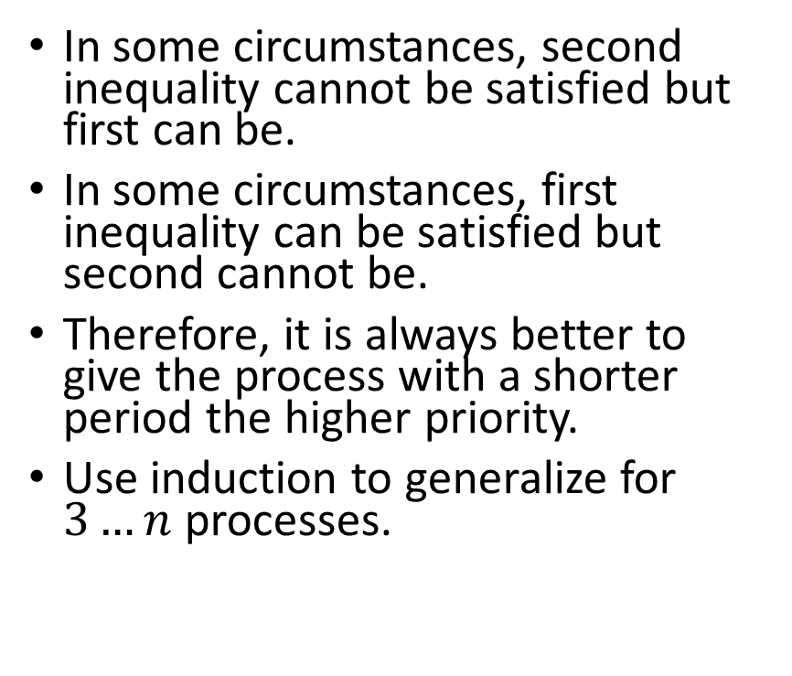
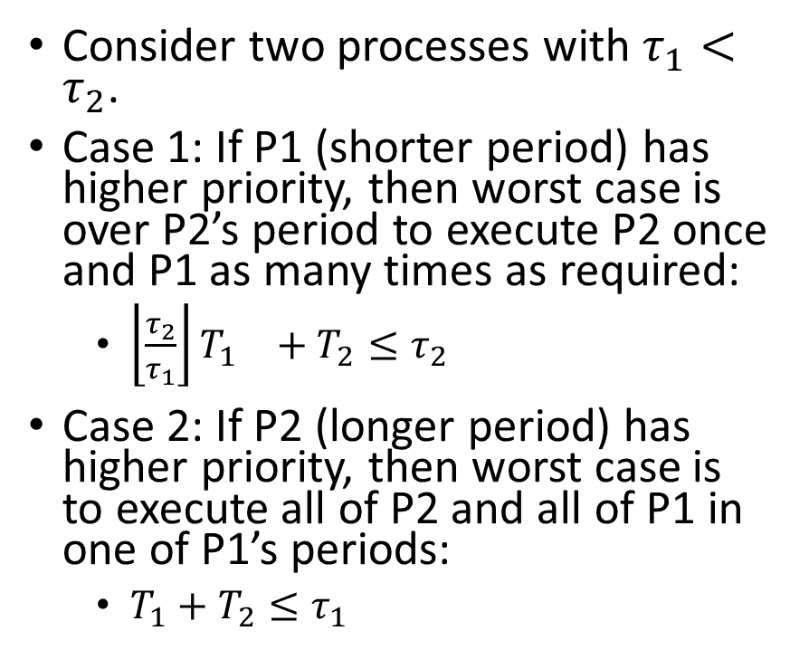
RMS optimality
Consider two processes with $τ_{1}<τ_{2}$.
Case 1: If P1 (shorter period) has higher priority, then worst case is over P2’s period to execute P2 once and P1 as many times as required:
${\left\lfloor \frac{τ_{2}}{τ_{1}}\right\rfloor T_{1}}_{}+T_{2}≤τ_{2}$
Case 2: If P2 (longer period) has higher priority, then worst case is to execute all of P2 and all of P1 in one of P1’s periods:
$T_{1}+T_{2}≤τ_{1}$
In some circumstances, second inequality cannot be satisfied but first can be.
In some circumstances, first inequality can be satisfied but second cannot be.
Therefore, it is always better to give the process with a shorter period the higher priority.
Use induction to generalize for $3…n$ processes.

Slide 28
RMS example
P2 period
P2
P1 period
P1
P1
P1
0
5
10
time

Slide 29
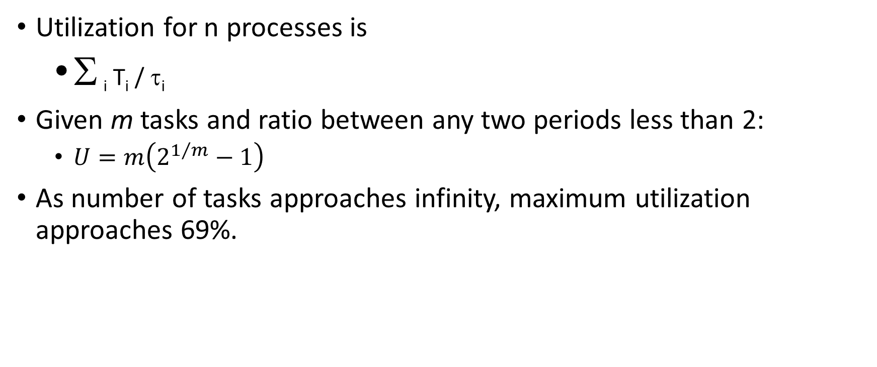
RMS CPU utilization
Utilization for n processes is
Σ _{i} T_{i} / τ_{i}
Given m tasks and ratio between any two periods less than 2:
$U=m\left(2^{1/m}−1\right)$
As number of tasks approaches infinity, maximum utilization approaches 69%.

Slide 30
RMS CPU utilization, cont’d.
RMS may not be able to use 100% of CPU, even with zero context switch overhead.
Must keep idle cycles available to handle worst-case scenario.
However, RMS guarantees all processes will always meet their deadlines.

Slide 31
RMS implementation
Efficient implementation:
scan processes;
choose highest-priority active process.

Slide 32
Earliest-deadline-first scheduling
EDF: dynamic priority scheduling scheme.
Process closest to its deadline has highest priority.
Requires recalculating processes at every timer interrupt.

Slide 33
EDF analysis
EDF can use 100% of CPU.
But EDF may fail to miss a deadline.

Slide 34
EDF implementation
On each timer interrupt:
compute time to deadline;
choose process closest to deadline.
Generally considered too expensive to use in practice.

Slide 35
RMS vs. EDF
P₁
RMS
P₂
EDF
P₃
0
6
12

Slide 36
Fixing scheduling problems
What if your set of processes is unschedulable?
Change deadlines in requirements.
Reduce execution times of processes.
Get a faster CPU.

Slide 37
Race condition in shared memory
Problem when two CPUs try to write the same location:
CPU 1 reads flag and sees 0.
CPU 2 reads flag and sees 0.
CPU 1 sets flag to one and writes location.
CPU 2 sets flag to one and overwrites location.

Slide 38
Atomic test-and-set
Problem can be solved with an atomic test-and-set:
single bus operation reads memory location, tests it, writes it.
ARM test-and-set provided by SWP:
ADR r0,SEMAPHORE
LDR r1,#1
GETFLAG SWP r1,r1,[r0]
BNZ GETFLAG

Slide 39
Semaphores
Semaphore: OS primitive for controlling access to critical regions.
Protocol:
Get access to semaphore with P().
Perform critical region operations.
Release semaphore with V().

Slide 40
Critical regions
Critical region: section of code that cannot be interrupted by another process.
Examples:
writing shared memory;
accessing I/O device.

Slide 41
Priority inversion
Priority inversion: low-priority process keeps high-priority process from running.
Improper use of system resources can cause scheduling problems:
Low-priority process grabs I/O device.
High-priority device needs I/O device, but can’t get it until low-priority process is done.
Can cause deadlock.

Slide 42
Solving priority inversion
Give priorities to system resources.
Have process inherit the priority of a resource that it requests.
Low-priority process inherits priority of device if higher.

Slide 43
Scheduling for low power
EDF with DVFS:
First set the clock speed to meet the performance goal in the critical interval.
Set clock speed for less-critical intervals in order of importance.
RMS with DVFS is NP-complete.
RMS/EDF with race-to-dark is currently handled with heuristics.

Slide 44
Data dependencies
Data dependencies allow us to improve utilization.
Restrict combination of processes that can run simultaneously.
P1 and P2 can’t run simultaneously.
P3 can preempt P1 or P2 but not both.
P1
P3
P2

Slide 45
Context-switching time
Non-zero context switch time can push limits of a tight schedule.
Hard to calculate effects---depends on order of context switches.
In practice, OS context switch overhead is small (hundreds of clock cycles) relative to many common task periods (ms – μs).

